Slide 1
Mein Traumzimmer
By the end of the lesson you will be able to describe your dream room

Slide 2
Die Möbel = furniture
Das Bett
Der Computer
Der Stuhl
Der Schrank
Der Fernseher
Der Tisch
Table
Computer
TV
Chair
Bed
Wardrobe

Slide 3
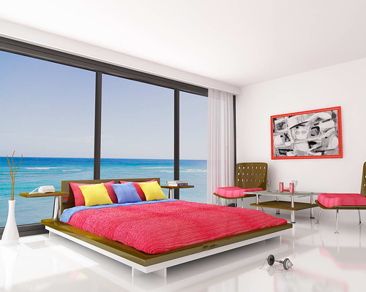
Mein Traumzimmer

Slide 4


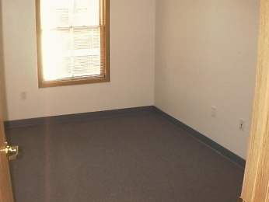



Make a poster that shows what you have in your bedroom (real or imaginary). Draw and label the objects in the room.
If you want to, you can add more detail like what colour the walls/curtains/carpet are, using the following to help you.
In meinem Traumzimmer habe ich …
Die Wände sind...
Die Gardinen sind...
Der Teppich ist...
blau
gelb
grün
rot
weiß
lila
bunt
An den Wänden habe ich …

Slide 5

Frohe Ostern!

